Slide 1






AI powered regulatory compliance checker for contracts
Presented by:
Ganashree P M
AI intern
Infosys Springboard 6.0

Slide 2




Problem Statement
Ensuring that legal contracts comply with the General Data Protection Regulation (GDPR) is often a complex and time-consuming process prone to human error. Manual reviews of lengthy agreements make it difficult to consistently identify missing or non-compliant clauses.
To overcome this challenge, the Contract Compliance Checker automates the process using AI to extract, analyze, and compare contract clauses against standardized GDPR templates, enabling faster, more accurate, and consistent compliance verification.

Slide 3
Objectives
Automate Contract Review
Ensure Continuous Compliance
Enable Proactive Monitoring
To design an intelligent system that automatically extracts, analyzes, and compares clauses from GDPR-related agreements using AI
To maintain up-to-date GDPR templates, detect missing or non-compliant clauses, assess potential risks through structured analysis and scoring
To implement automated notifications via Slack and email that alert the working team or administrators about JSON updates, detected errors, and compliance results

Slide 4
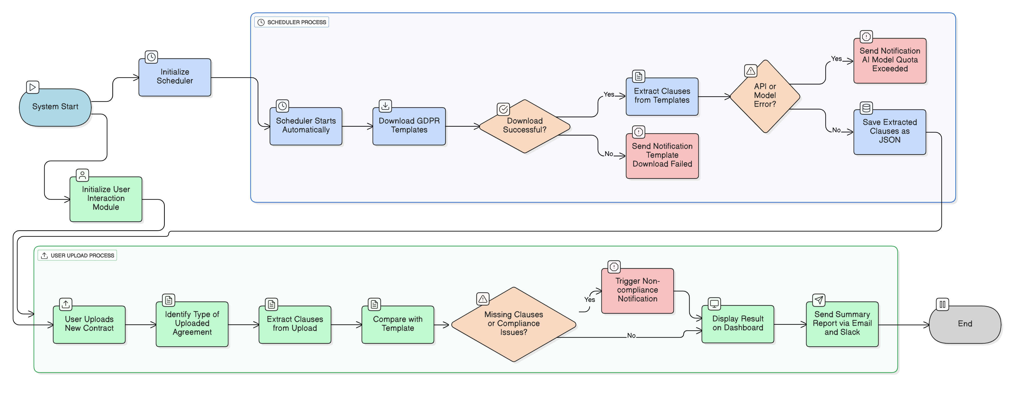
Flowchart

Slide 5
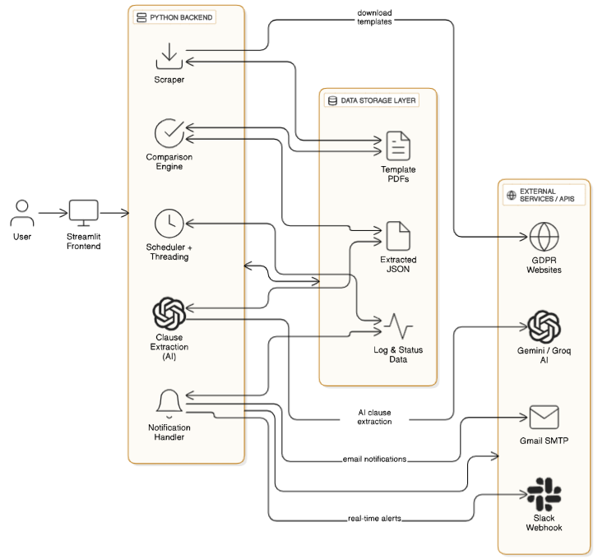
PYTHON BACKEND
System
Architecture

Slide 6
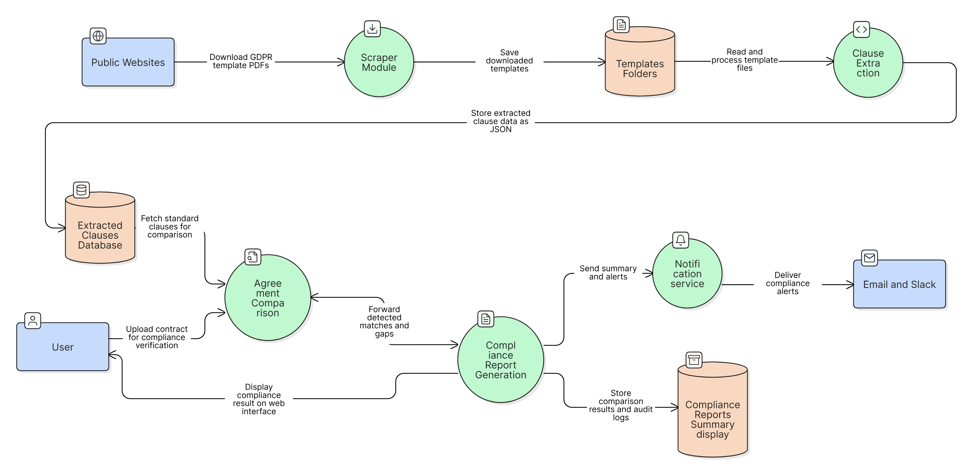
Data Flow diagram

Slide 7
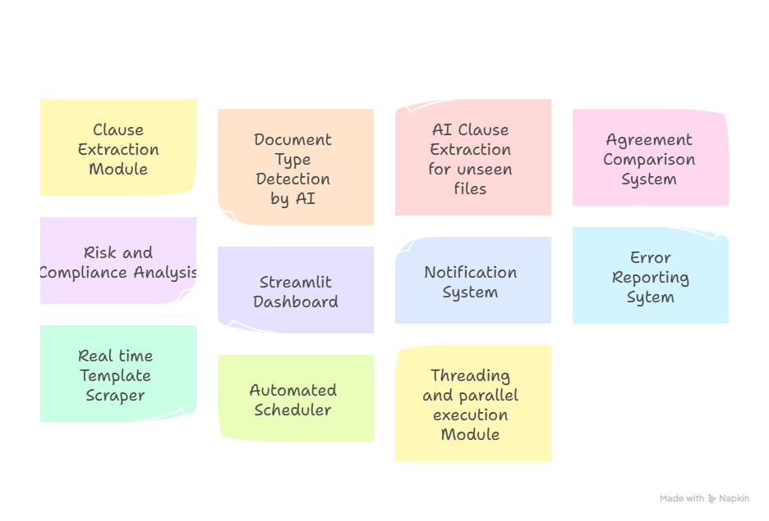
Module Overview

Slide 8
Milestones
Milestone | Duration | Key Outcomes
M1 (Weeks 1–2) | Setup and Training | Data collection and LLM familiarization
M2 (Weeks 3–4) | Clause & Risk Analysis | Automated clause identification
M3 (Weeks 5–6) | Regulatory Updates & Modification | Update tracking and contract amendment system
M4 (Weeks 7–8) | Integration & Deployment | Notifications through email and Slack.

Slide 9
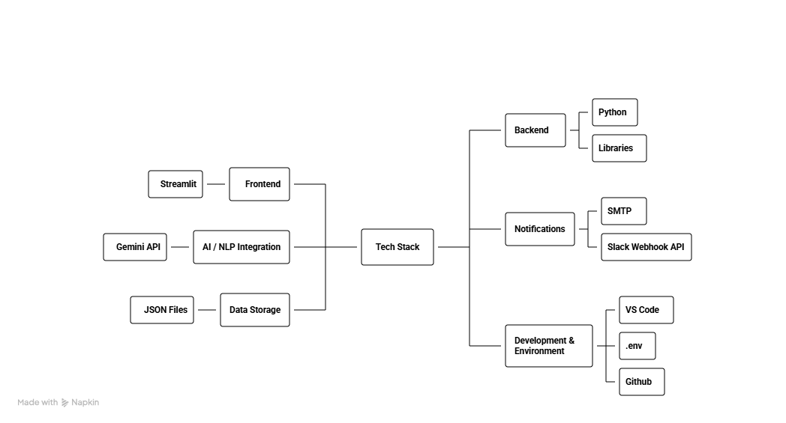
Tech stacks

Slide 10
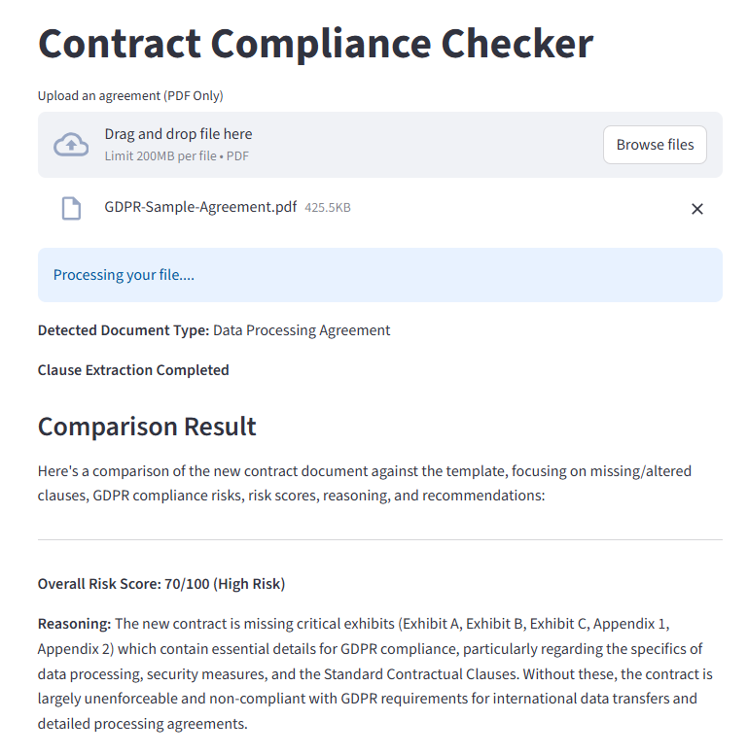
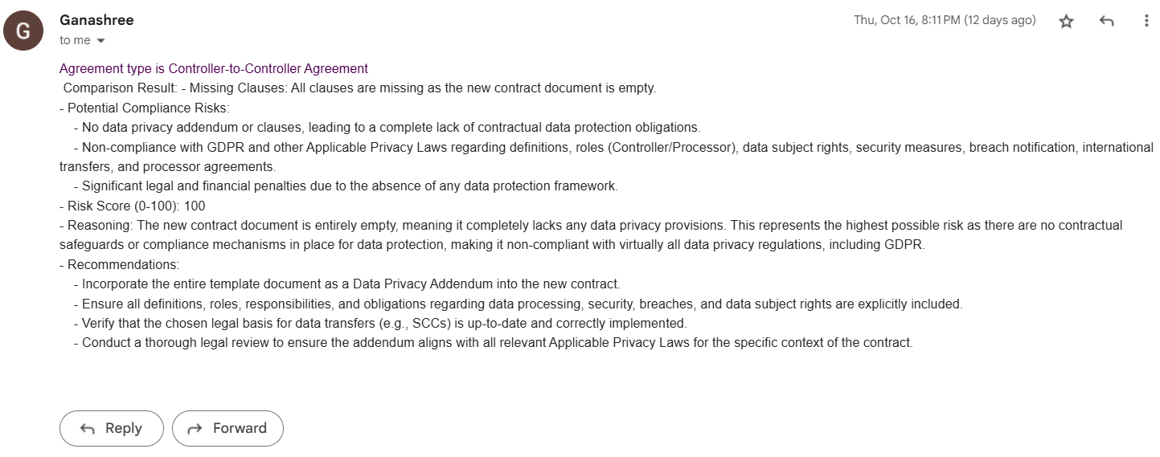
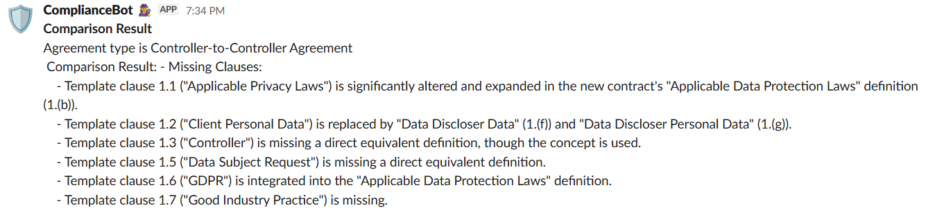
Expected Outcomes

Slide 11
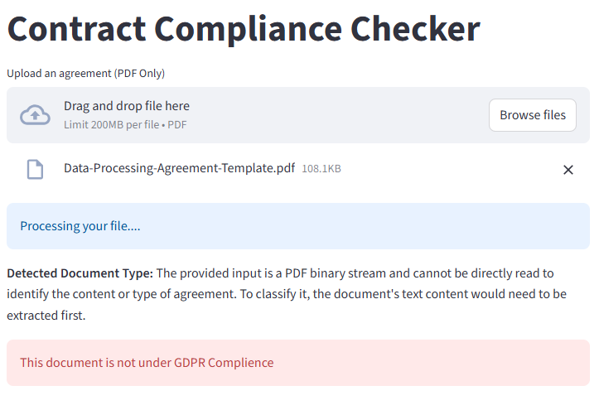
Testing and Challenge

Slide 12
Future Enhancements
Interactive Visual Dashboard: Add a graphical dashboard to display compliance percentage, clause-wise comparison, and improvement trends over time.
Multi-File Batch Processing: Enable bulk upload and comparison of multiple agreements simultaneously to save time in enterprise use cases.
Smart Learning Engine: Use feedback and previous comparison data to improve the accuracy of document type detection and clause interpretation.
Automated Report Generation: Generate downloadable PDF compliance summaries with highlights and suggested corrective actions.
Cloud Deployment & Collaboration: Host the system on a secure cloud platform, allowing multiple users to collaborate, review, and manage compliance reports remotely.

Slide 13
Conclusion
The AI Powered Compliance Checker successfully automates the complex process of evaluating data protection agreements using AI. By integrating clause extraction, document type detection, and intelligent comparison with standard templates, the system provides a clear, structured, and accurate compliance overview.
Through real-time notifications, scheduled template updates, and a user-friendly dashboard, it ensures organizations remain aligned with evolving regulatory standards. The project demonstrates how artificial intelligence can enhance legal compliance, reduce manual review time, and improve transparency in data governance.
Overall, this system represents a significant step towards smarter, faster, and more reliable GDPR compliance management — setting the foundation for scalable enterprise-level automation in the future.

Slide 14
Thank You Very Much!

